Slide 1
DPDA
Deterministic PDA

Slide 2
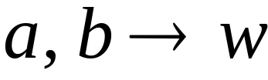


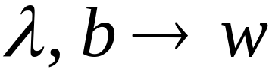


Deterministic PDA: DPDA
Allowed transitions:
(deterministic choices)

Slide 3
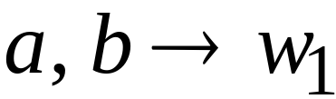
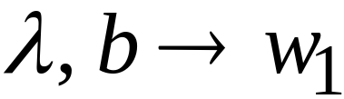
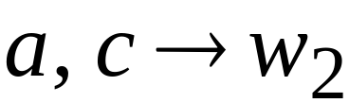
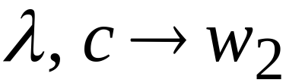

Allowed transitions:
(deterministic choices)

Slide 4
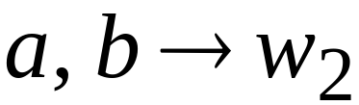
Not allowed:
(non deterministic choices)

Slide 5
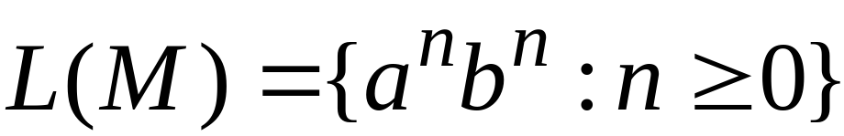




DPDA example

Slide 6

Definition:
A language is deterministic context-free
if there exists some DPDA that accepts it
Example:
The language
is deterministic context-free

Slide 7
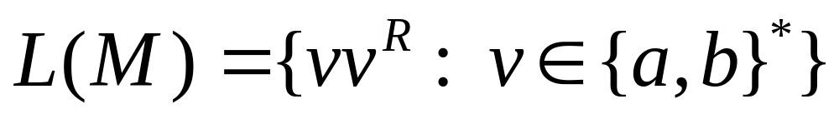
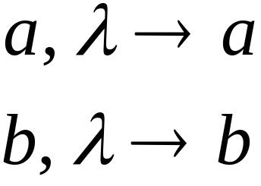
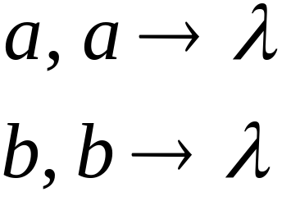

Example of Non-DPDA (PDA)

Slide 8
Not allowed in DPDAs

Slide 9
PDAs
Have More Power than
DPDAs

Slide 10
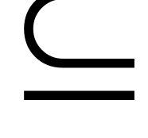
It holds that:
Deterministic
Context-Free
Languages
(DPDA)
Context-Free
Languages
PDAs
Since every DPDA is also a PDA

Slide 11


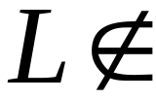
We will actually show:
Deterministic
Context-Free
Languages
(DPDA)
Context-Free
Languages
(PDA)
We will show that there exists
a context-free language which is not
accepted by any DPDA

Slide 12
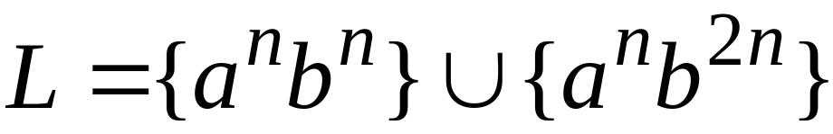

The language is:
We will show:
is context-free
is not deterministic context-free

Slide 13


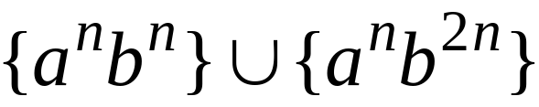
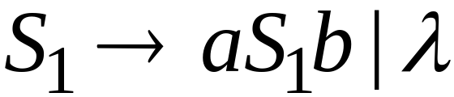
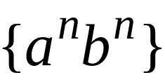
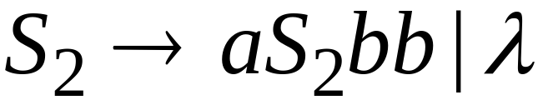
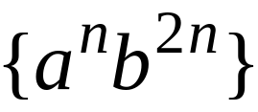
Language is context-free
Context-free grammar for :

Slide 14
Theorem:
The language
is not deterministic context-free
(there is no DPDA that accepts )

Slide 15

Proof:
Assume for contradiction that
is deterministic context free
Therefore:
there is a DPDA that accepts

Slide 16
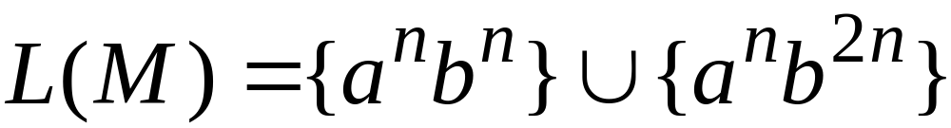
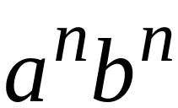
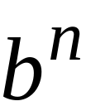
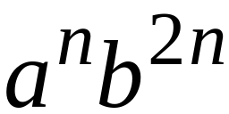
DPDA with
accepts
accepts

Slide 17
DPDA with
Such a path exists due to determinism

Slide 18
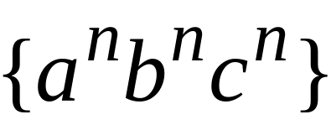


Fact 1:
The language
is not context-free
Context-free languages
Regular languages
(we will prove this at a later class using
pumping lemma for context-free languages)

Slide 19
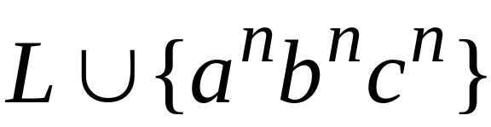
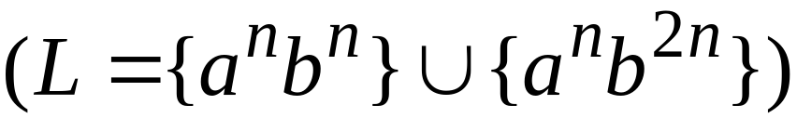
Fact 2:
The language
is not context-free
(we can prove this using pumping lemma
for context-free languages)

Slide 20
We will construct a PDA that accepts:
which is a contradiction!

Slide 21
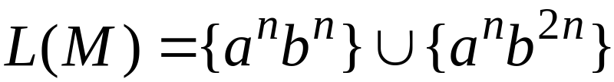



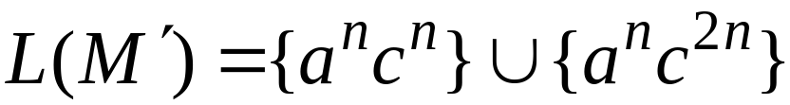
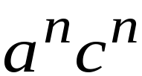

DPDA
Modify
Replace
with
DPDA

Slide 22








A PDA that accepts
Connect the final states of
with the final states of

Slide 23
Since is accepted by a PDA
it is context-free
Contradiction!
(since is not context-free)

Slide 24
Therefore:
Is not deterministic context free
There is no DPDA that accepts it
End of Proof

